Slide 1


Food Sales Predictions
By Tanner Gorman

Slide 2
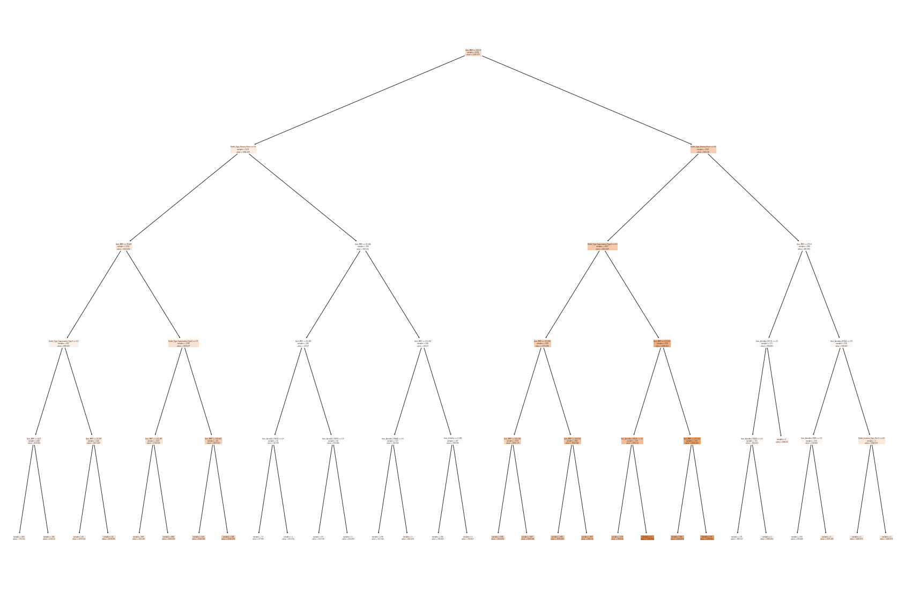
Learning Objectives
Understand Visualizations and predict future sales based on the following categories.
Item_Identifier---------------- Unique product ID
Item_MRP---------------------- Maximum retail price
Outlet_Location_Type----- Type of area Store is located
Outlet_Type------------------- Grocery store or Supermarket.
Item_Outlet_Sales----------- Sales of product in store.
Item_Visibility------------------ Percentage of visibility in store
Item_Type----------------------- Category of the product.

Slide 3
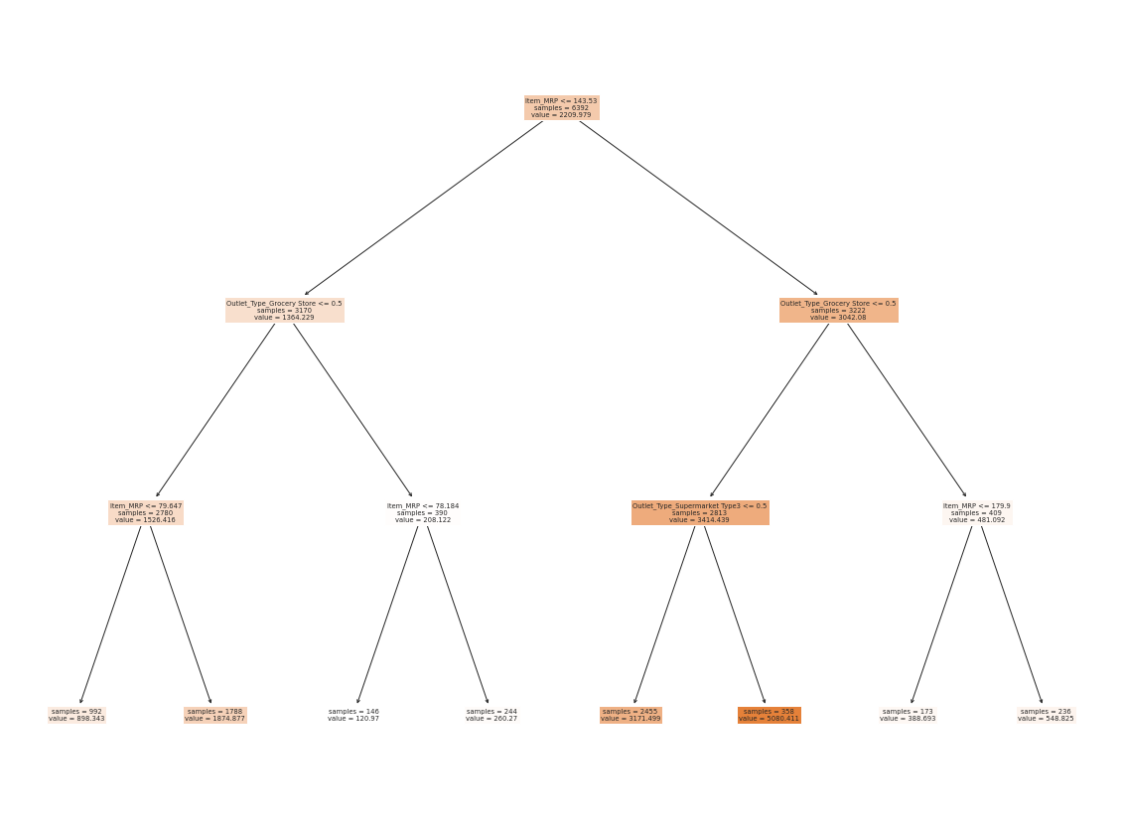
Decision Tree (Bias)
Data is portrayed as a series of data split off into subcategories, if meeting criteria the statement is highlighted.(True).
In example highlighted in Green
If outlet type is Supermarket type 3
Greater than .5 in 2813 samples
With value of 3414.439

Slide 4
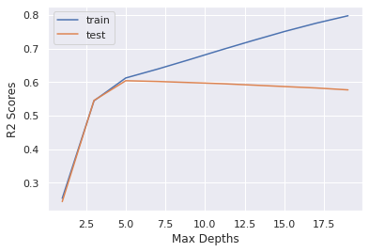
Final DATA VISUALIZATION
R2 or R-squared is a goodness-of-fit measure for linear regression models. This statistic indicates the percentage of the variance in the train variable that the test variables predict collectively.
R2 range on Y-axis (up and down) showcases a .6 meaning a moderate capability to predict inside a depth of 5.
Max Depth of 5 show cased here shows that beyond 5 our predictive confidence would steadily decrease as we travel further into our visualization.

Slide 5
Summary
With data collected and presentation as shows viability of using selected data could be quantifiable inside unique parameters, though as an all-encompassing model to set a business plan upon would be ill advised beyond specific parameters.

